Slide 1
Plant Monitoring System

Slide 2
Project Background
The Idea
Hackster.io
https://www.hackster.io/ryanjgill2/plant-monitoring-system-88ed2b?ref=search&ref_id=plant&offset=1
My indoor plants
Markets that I seek
Lazy people with plants
What does it do?

Slide 3
Initial implementation
How have I deviated from the original Idea?
More simple
Simple architecture
Implemented in class exercises
Most Important pieces of the System
Moisture sensor
Photon server & IFTTT
Architecture of the components
Moisture sensor
Temperature sensor
RBG light (Initially wanted to use a LCD)

Slide 4
Iterations
Failures
What did I break ?
1 photon
1 breadboard
Few resistors
Mistakes
Code – lot of revision needed
What I learned?
Coding was the easier part
How I wanted to integrate it

Slide 5
Final Implementation
What lead me to the final implementation?
Simplicity
Calm technology maybe?
Best Approach
Integrating IFTTT, Photon and my phone.

Slide 6
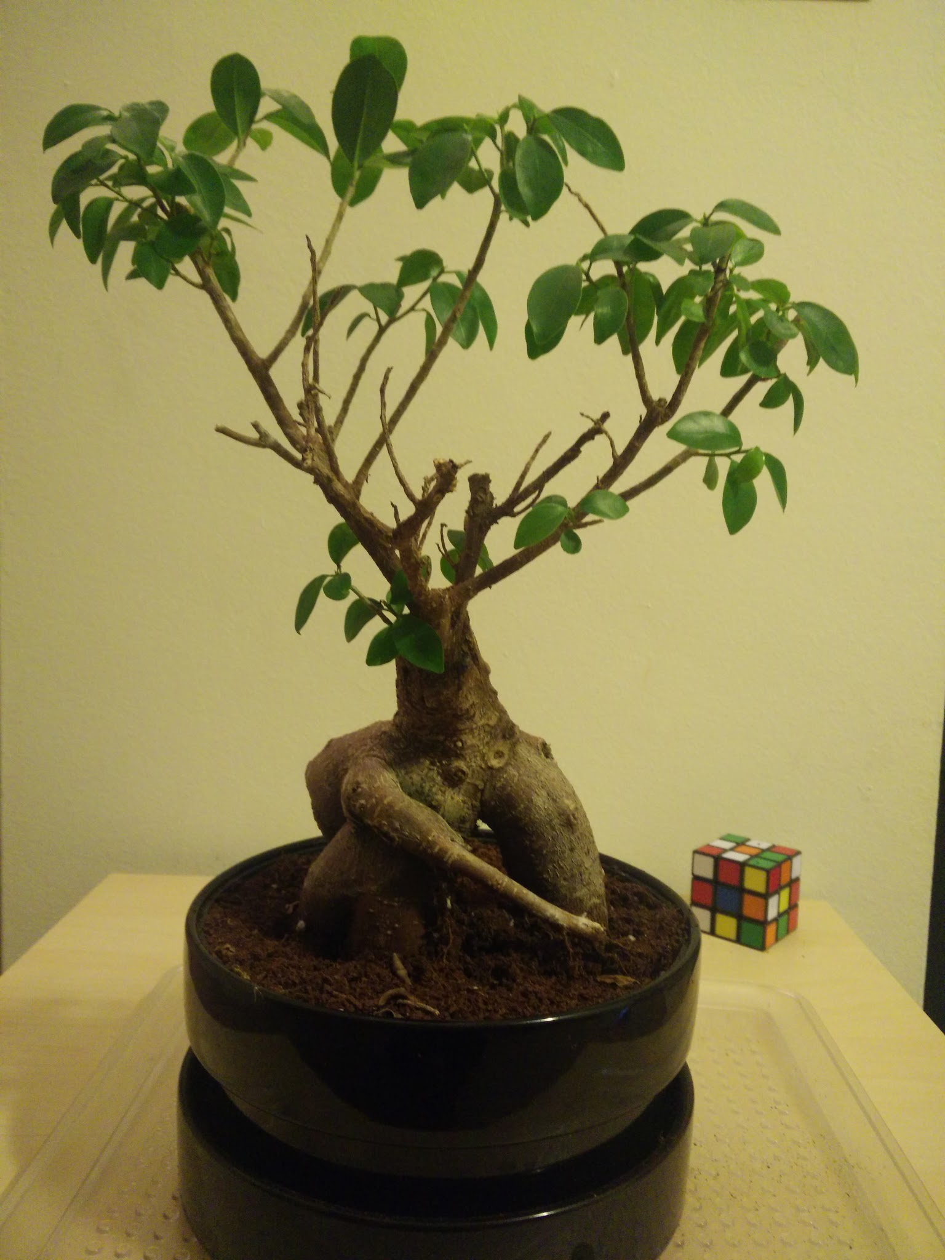
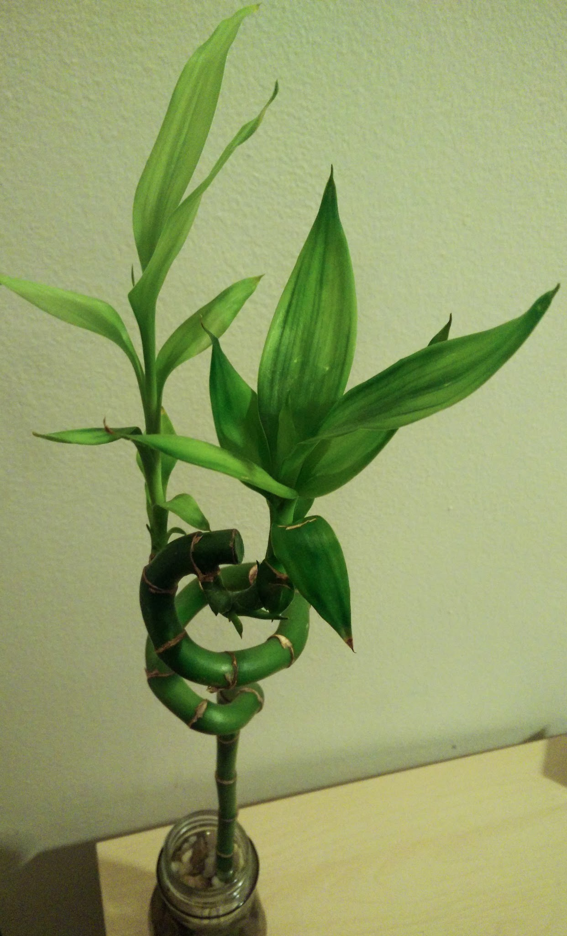
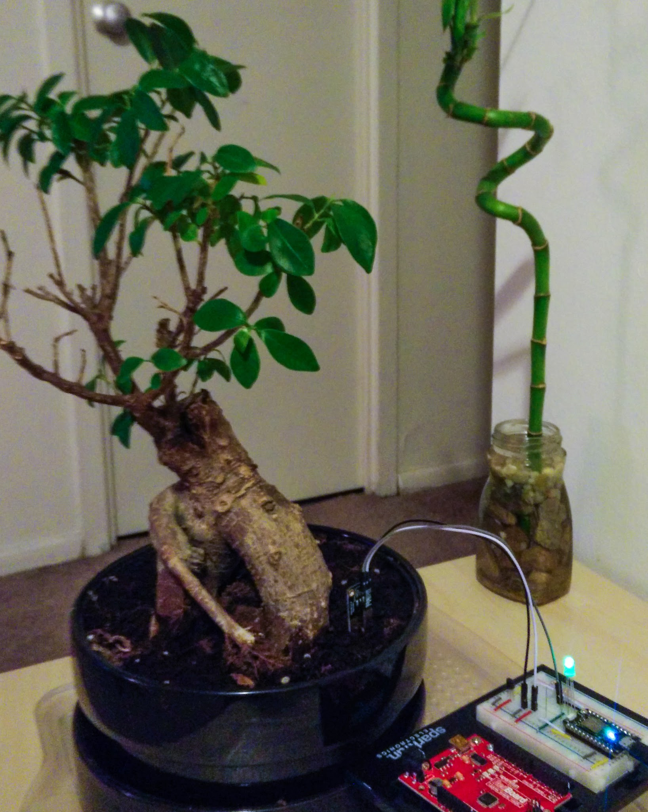
DEMO

Slide 7
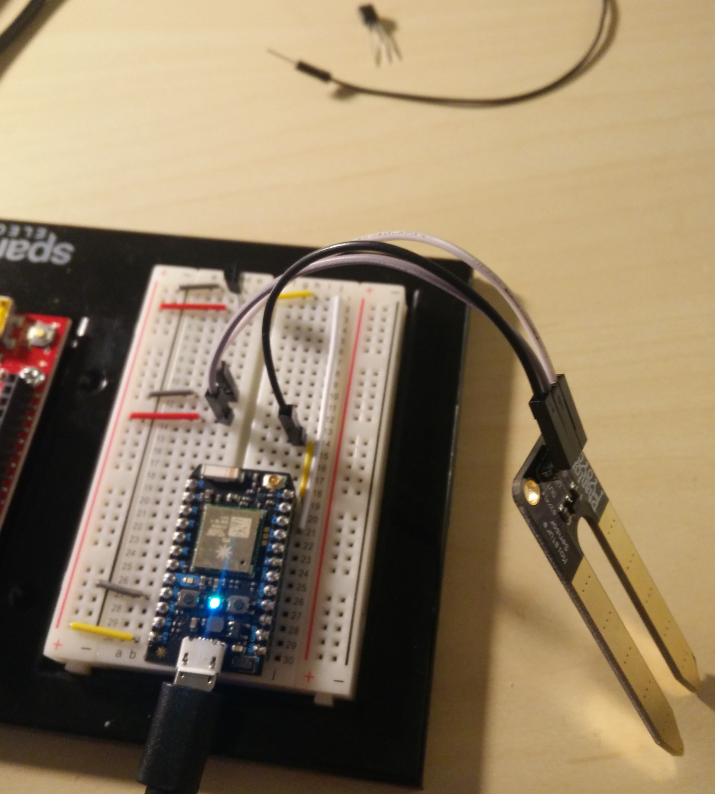
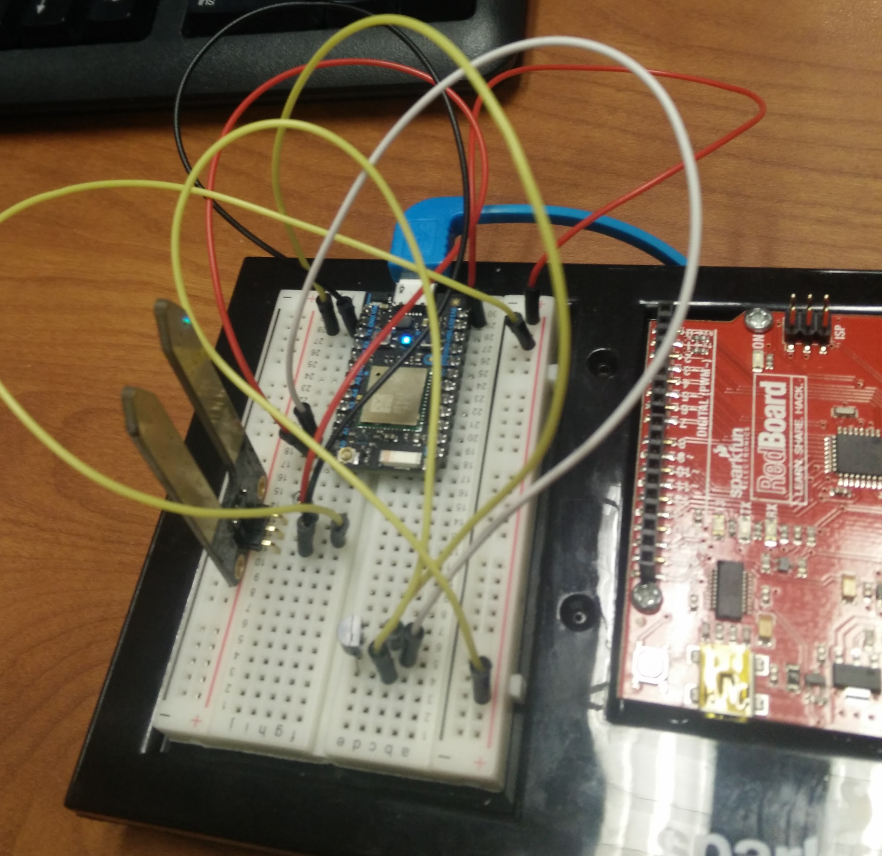
DEMO
Towards the end
Initial when I started

Slide 8
If I had more time…...
Few more functionalities using additional modules
A bigger breadboard
More efficient code
Make efficient for different plants
Most importantly a UI interface on a phone or a web-browser to toggle the settings.

